Slide 1
SPRING VALLEY VILLAGE POLICE DEPARTMENT
MONTHLY NEWSLETTER:
MARCH 2025
1025 CAMPBELL ROAD
HOUSTON, TX 77055
PHONE: 713-465-8323
COMMUNITY MATTERS.
WE ARE A TEAM.

Slide 2
INTRODUCTION
Hilshire Village Residents,
Spring is just around the corner, which means warmer weather and Spring Break cannot be far behind. Below are a few things to keep in mind while you go about your day-to-day activities. As always, we are available whenever you have concerns.
KEEP IN MIND:
Be aware of increased activity regarding children playing outside.
Be sure to lock all doors and windows in your home, when you are not on the premises.
Be sure to set the alarm for your residence and vehicle.
Lock your vehicle when it is unoccupied.
Sincerely,
Chief M. Schulze
1025 CAMPBELL ROAD, HOUSTON, TX 77055
PHONE: 713-465-8323 / EMAIL: DISPATCH@SPRINGVALLEYTX.COM

Slide 3
MARCH 2025
DATE | DAY | SPECIAL DAYS FOR THIS MONTH
03-09-2025 | SUNDAY | DAYLIGHT SAVINGS TIME BEGINS
03-10-2025 | MONDAY | SBISD SPRING BREAK BEGINS
03-14-2025 | FRIDAY | SBISD SPRING BREAK ENDS
03-17-2025 | MONDAY | ST. PATRICK’S DAY
03-20-2025 | THURSDAY | FIRST DAY OF SPRING
COMMUNITY MATTERS.
WE ARE A TEAM.
1025 CAMPBELL ROAD, HOUSTON, TX 77055 / PHONE: 713-465-8323 / EMAIL: DISPATCH@SPRINGVALLEYTX.COM

Slide 4
PPublic Service Announcement (PSA) From Our Officers:
Make sure your garage and exterior doors are secured and locked at night. This includes your vehicles as well.
Sgt. A. Clawson
Make sure your house numbers are large, visible, and lighted, if possible, to ensure a quick response in locating your residence.
Officer R. Leal
Make sure your bicycles are secured for the night. As always be mindful of your package deliveries and secure them as soon as possible, or have a neighbor secure them for you.
Officer R. Martell
COMMUNITY MATTERS.
WE ARE A TEAM.
1025 CAMPBELL ROAD, HOUSTON, TX 77055 / PHONE: 713-465-8323 / EMAIL: DISPATCH@SPRINGVALLEYTX.COM

Slide 5
Public Service Announcement (PSA) From Our Dispatchers:
Help 9-1-1 Help You
Every second counts in emergency. Don’t hesitate to contact 9-1-1 first during an emergency for police, fire or medical assistance.
Get to a safe location before calling. If you are calling to report a fire, exit the burning building before calling.
Stay calm and answer all questions about your emergency.
State what help you need: police, fire or EMS/medical.
State your address, describe your location as completely as possible using cross streets or landmarks.
Stay on the line — do not hang up until the operator says it’s OK.
COMMUNITY MATTERS.
WE ARE A TEAM.
1025 CAMPBELL ROAD, HOUSTON, TX 77055
PHONE: 713-465-8323 / EMAIL: DISPATCH@SPRINGVALLEYTX.COM

Slide 6
COMMUNITY MATTERS.
WE ARE A TEAM.
1025 CAMPBELL ROAD, HOUSTON, TX 77055 / PHONE: 713-465-8323 / EMAIL: DISPATCH@SPRINGVALLEYTX.COM

Slide 7
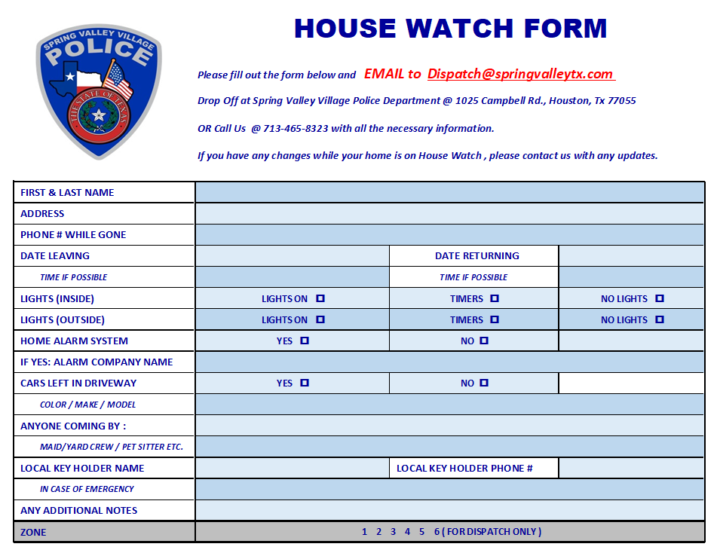
TIPS TO PREP BEFORE LEAVING
Close windows, blinds, curtains, shutters, lock all doors and garage.
Set timers on interior lights. This goes a long way in deterring burglars, who often look for crimes of opportunity.
Set your thermostat accordingly, for unnecessary energy cost, but can also help avoid unforeseen problems with you HVAC equipment.
Take out the trash.
Run garbage disposal until clear.
Secure all valuables.
Lock all vehicles that are at home.
Turn on home security system.
Arrange for pets left at home.

Slide 8
SPRING VALLEY POLICE DEPARTMENT
HILSHIRE VILLAGE
CALLS BY TYPE: 02-01-2025 THRU 02-28-2025
TYPE | DESCRIPTION | # OF CALLS
6 | ACCIDENT | 1
22 | ALARM | 3
23 | AMBULANCE CALL | 2
24 | ANIMAL CALL | 3
135 | BUSINESS CHECK | 827
68 | HOUSE CHECK | 82
70 | INFORMATION | 5
81 | OPEN DOOR | 2
162 | PARKING VIOLATION | 16
86 | PUBLIC RELATIONS | 53
96 | SOLICITOR | 2
97 | SPECIAL ASSIGNMENT | 2
104 | SUSPICIOUS PERSON | 1
105 | SUSPICIOUS VEHICLE | 1
108 | TRAFFIC CONTROL | 3
11 | TRAFFIC STOP | 21
117 | WELFARE CONCERN | 1
 | TOTAL | 1025
COMMUNITY MATTERS.
WE ARE A TEAM.
1025 CAMPBELL ROAD, HOUSTON, TX 77055
PHONE: 713-465-8323 / EMAIL: DISPATCH@SPRINGVALLEYTX.COM

Slide 9
IMPORTANT NUMBERS AT A GLANCE
EMERGENCY |  | NON - EMERGENCY
911 - FOR ALL EMERGENCY |  | 713-465-8323
988 – NATIONAL SUICIDE & MENTAL HEALTH
SPRING VALLEY VILLAGE |  | VILLAGE FIRE DEPARTMENT
SPRING VALLEY - CITY HALL | 713-465-8308 | VILLAGE FIRE DEPARTMENT |  | 713-465-2323
SPRING VALLEY - PD | 713-465-8323 | VFD - NON-EMERGENCY |  | 713-468-7941
SPRING VALLEY - PD FAX | 713-465-3135
SPRING VALLEY - COURT | 713-465-0333
HILSHIRE VILLAGE
HILSHIRE VILLAGE – CITY HALL | 713-973-1779
COMMUNITY MATTERS.
WE ARE A TEAM.
1025 CAMPBELL ROAD, HOUSTON, TX 77055 / PHONE: 713-465-8323 / EMAIL: DISPATCH@SPRINGVALLEYTX.COM

